Slide 1

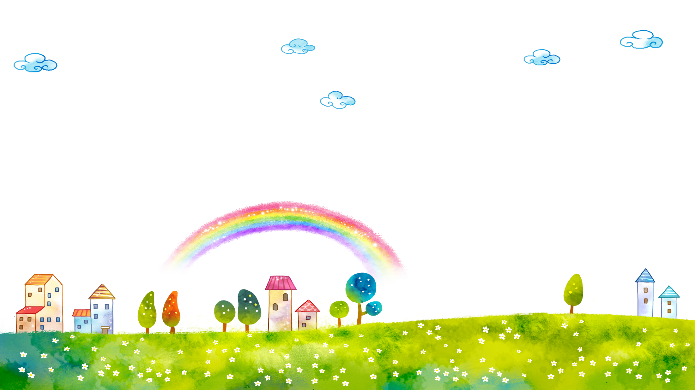
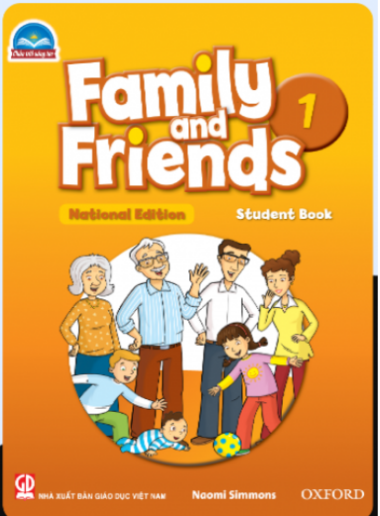

FAMILY &FRIENDS 1
National Edition

Slide 2
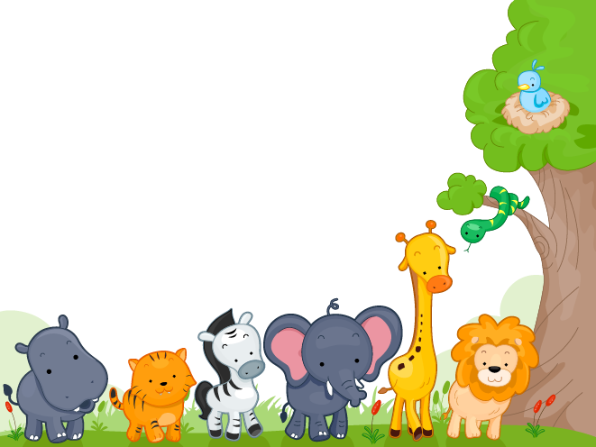

UNIT 4 : THEY’RE BEARS !
LESSON 2 : GRAMMAR and SONG

Slide 3





WARM UP

Slide 4
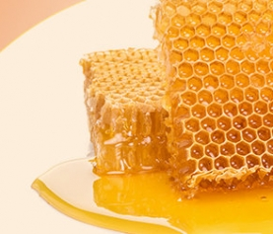
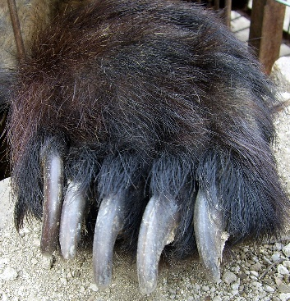
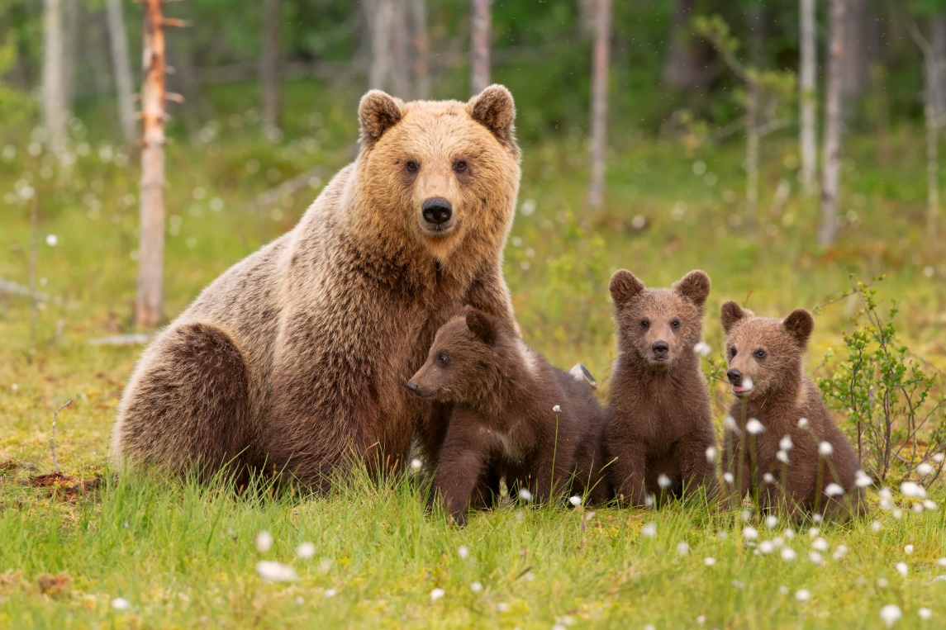
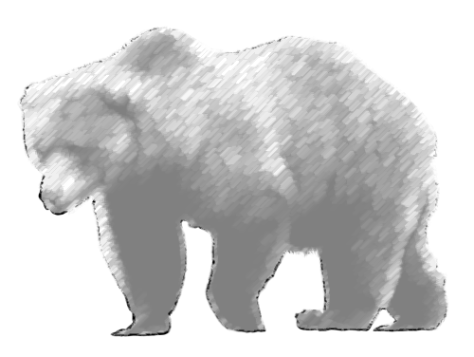

bear

Slide 5
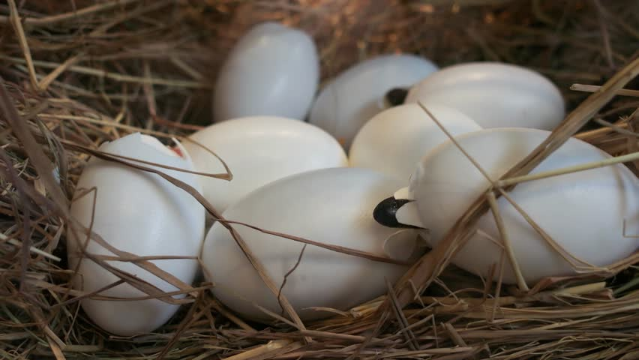
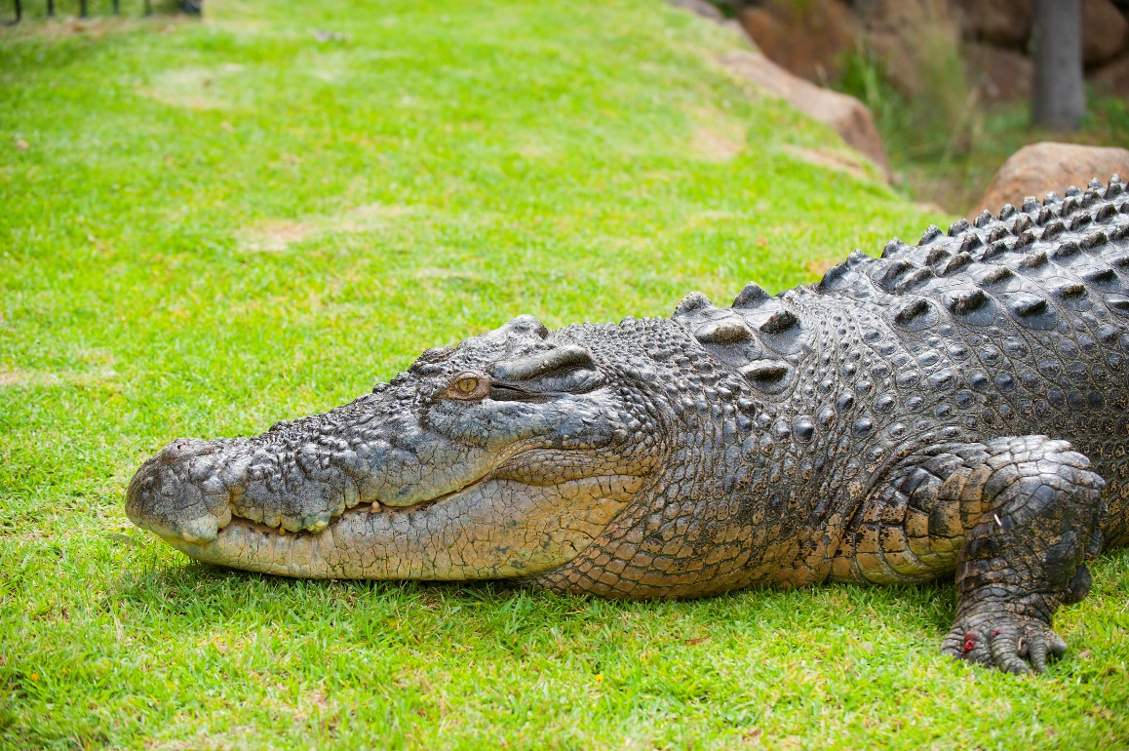
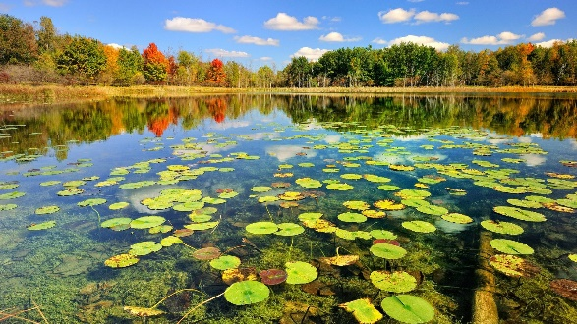
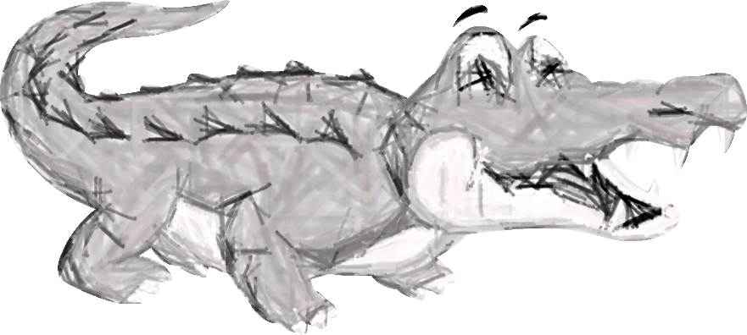
crocodile

Slide 6
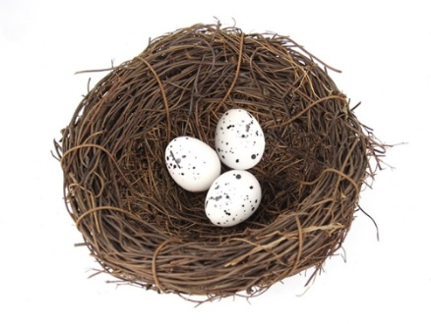
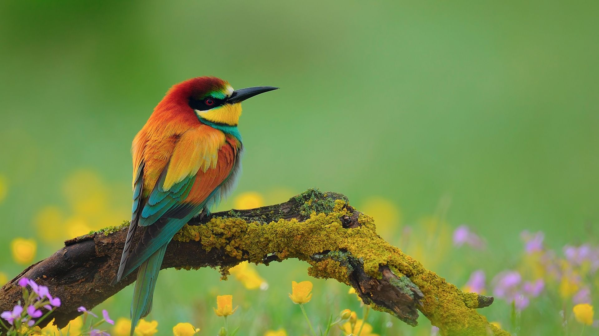
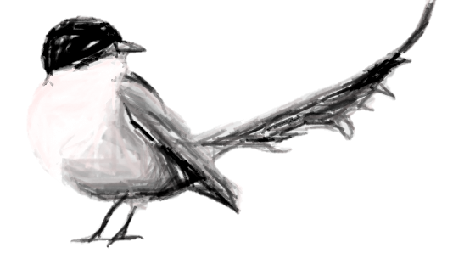
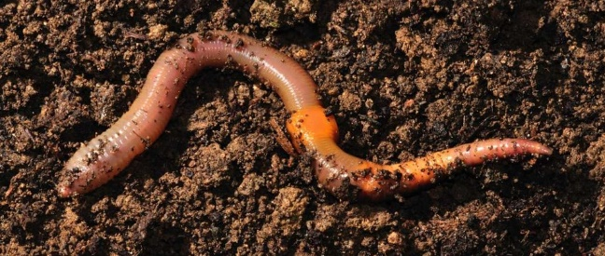
bird

Slide 7
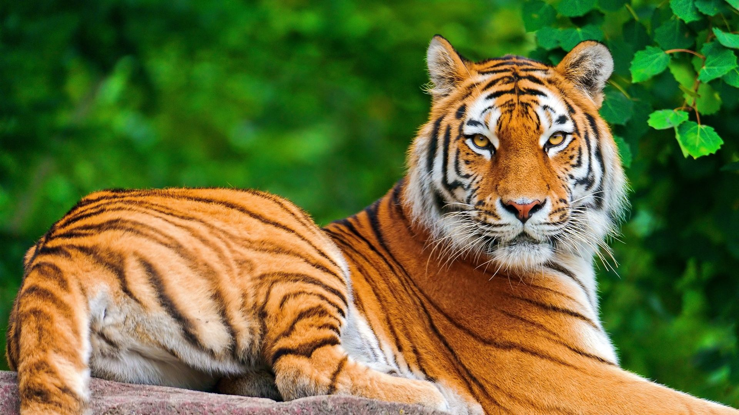

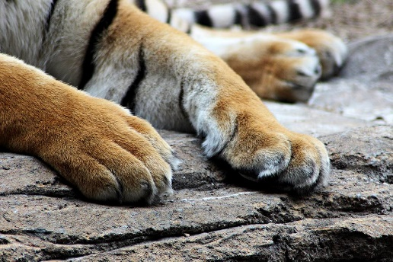
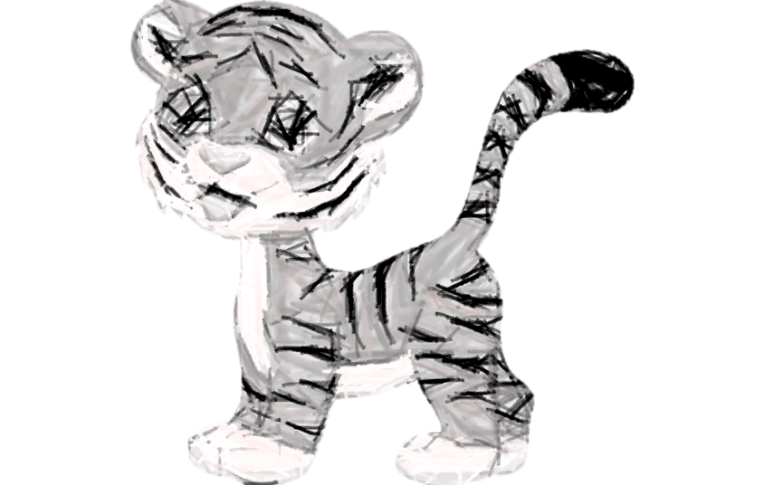
tiger

Slide 8
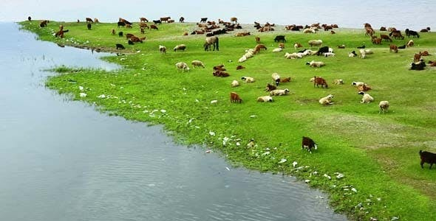
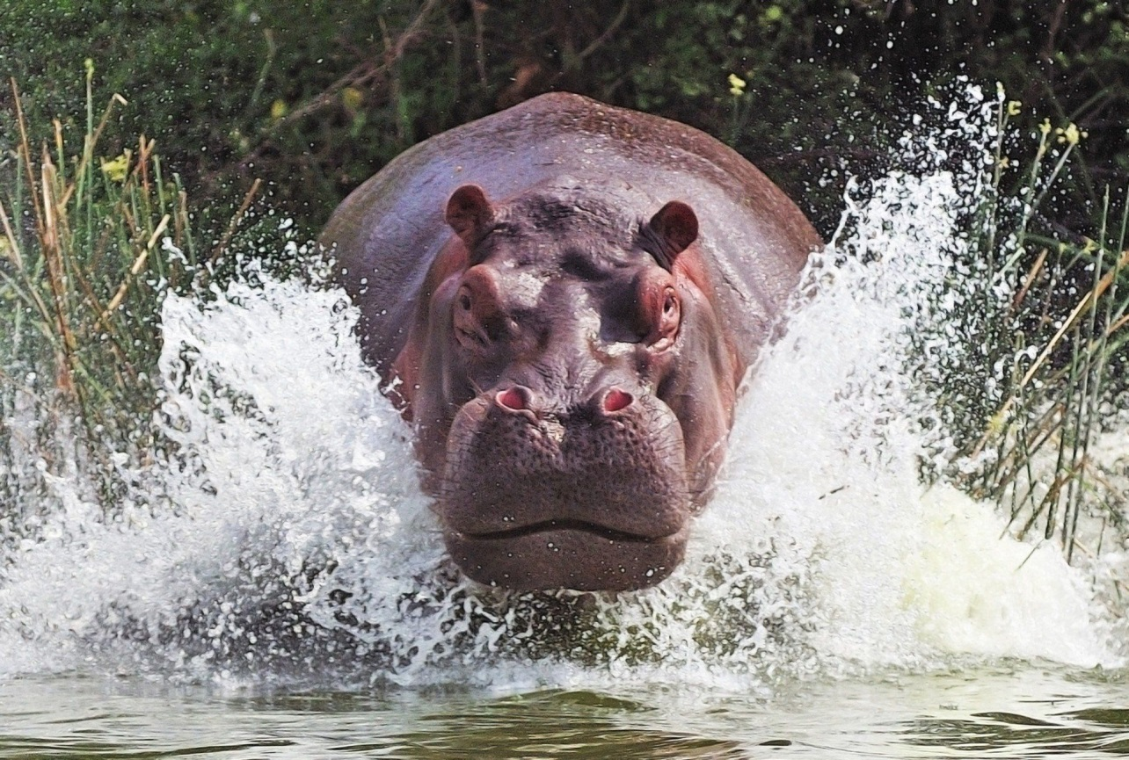
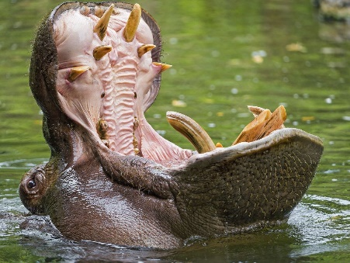
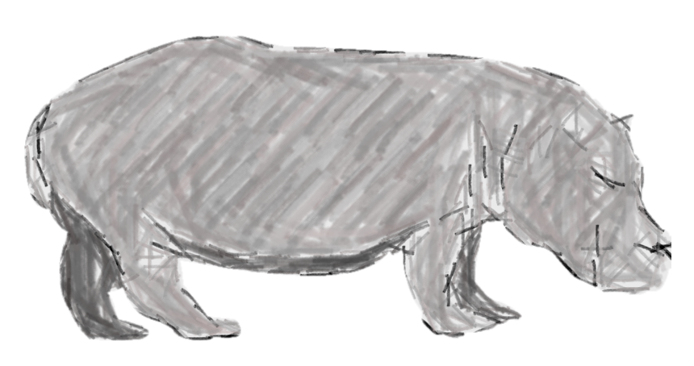
hippo

Slide 9

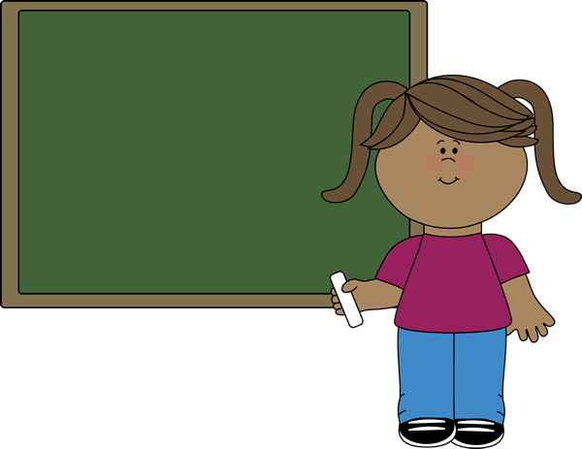
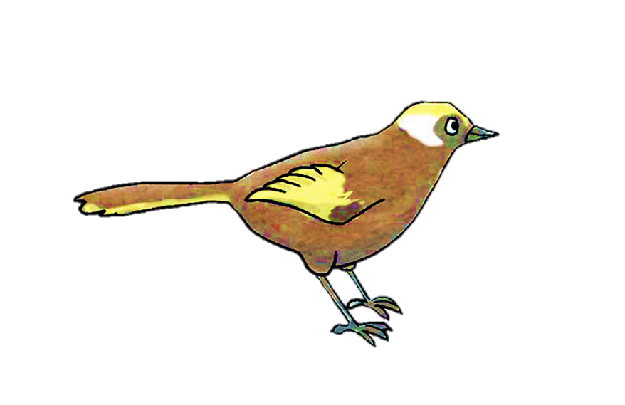
What’s this?
It’s a bird.
Notes:
- Say What’s this? Elicit It’s a bird.

Slide 10
What are they?
They’re birds.
Notes:
- Show more birds and say What are they? Say They’re birds.
- Practice plural forms of the other animals: hippos, bears, tigers, monkeys

Slide 11
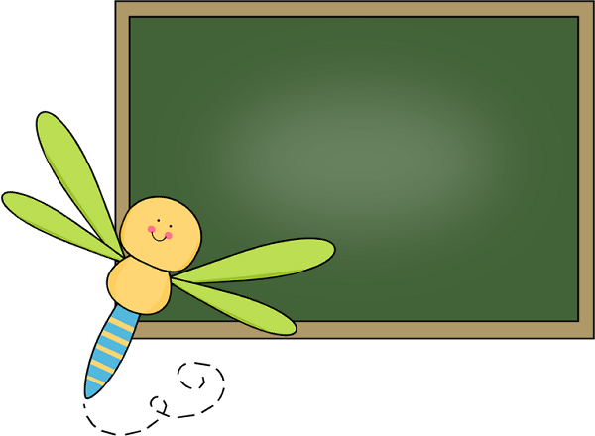
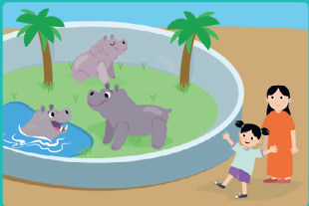
LISTEN and REPEAT
What are they?
They’re hippos.
Notes:
Listen and repeat track 52
- Play track 52, listen and point
- Play again, ask students to listen and point
- Play again, ask students to listen and repeat
•Below level:
- Bring out a flashcard, e.g., tiger. Hold up one finger and say tiger. Hold up three fingers and elicit three tigers.
- Pretend you can’t hear the s. Put your hand behind your ear and make the children shout the word, emphasizing the s.
- Repeat with different numbers and all the flashcards.
• At level: Carry out Exercise 2 as described above.
• Above level:
- Have two children come to the front of the class and stand back-to-back so that the class can only see one child.
- Whisper to them which animal they will mime, e.g., bear.
- The first child mimes being a bear, the class answers bear.
- The second child turns around and both children mime.
- The class responds with the plural form, bears.
- Repeat with different children and animal mimes.

Slide 12
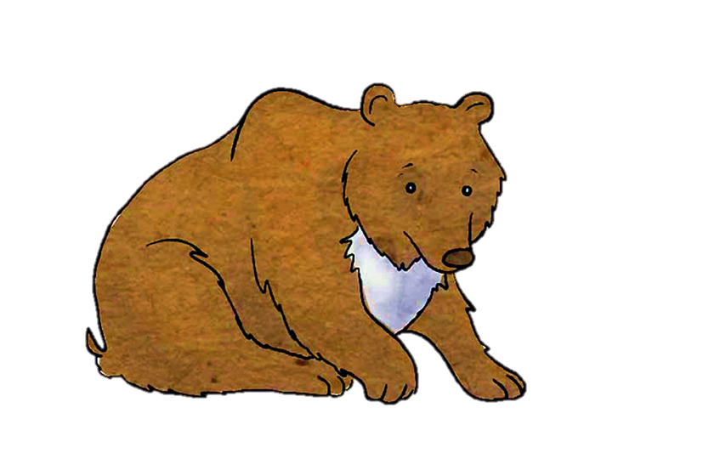

LISTEN and REPEAT
What are they?
They’re bears.

Slide 13
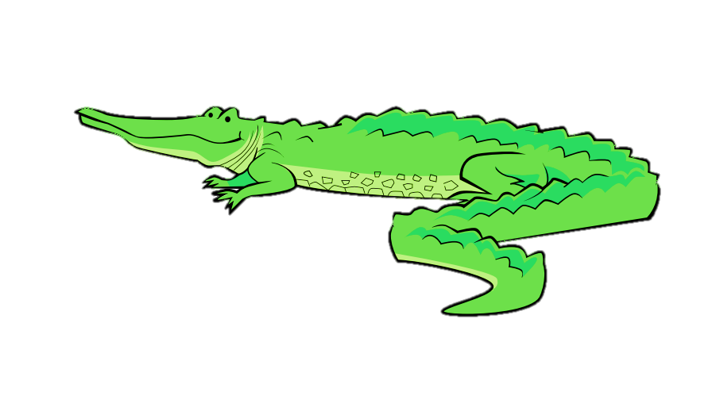
LISTEN and REPEAT
What are they?
They’re
crocodiles.

Slide 14
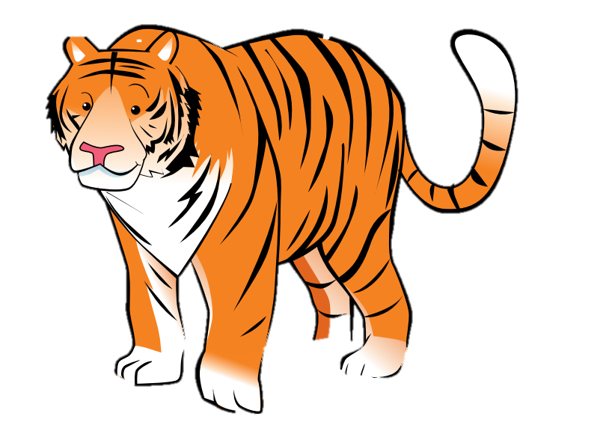
LISTEN and REPEAT
What are they?
They’re tigers.

Slide 15

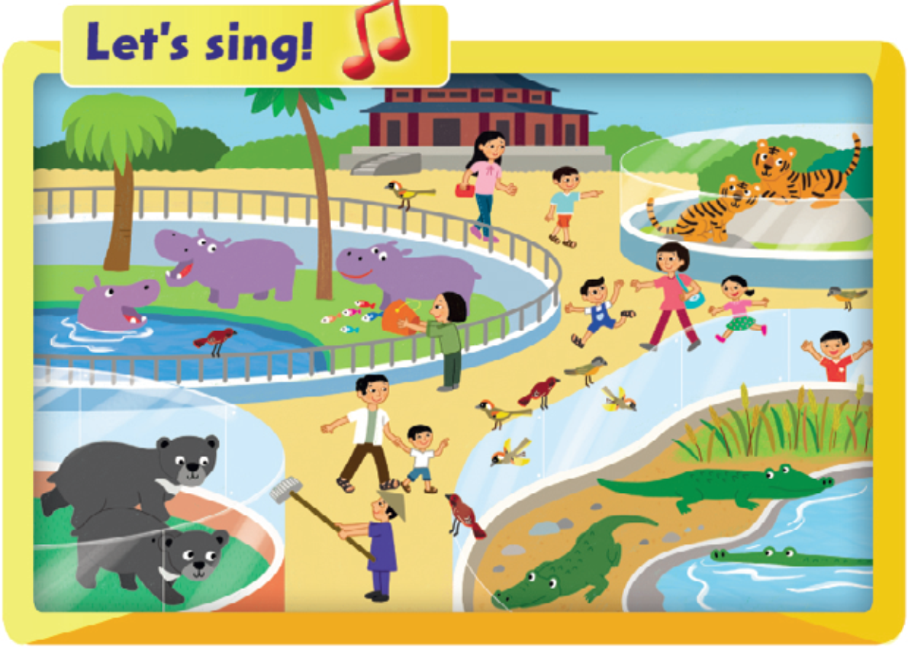




Notes:
- Point to the picture and say: What are they?
- Elicit the answer: They are… (tigers).
- Repeat with all animals with the whole class.

Slide 16

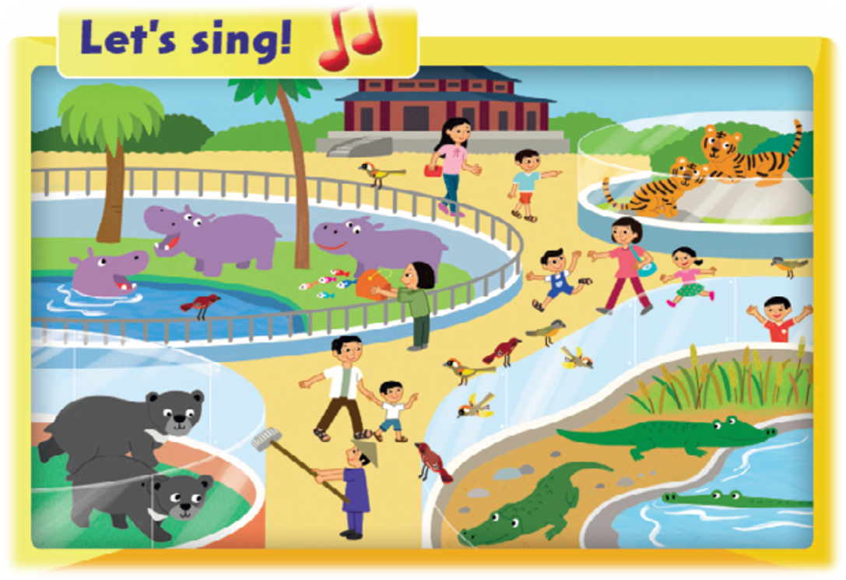
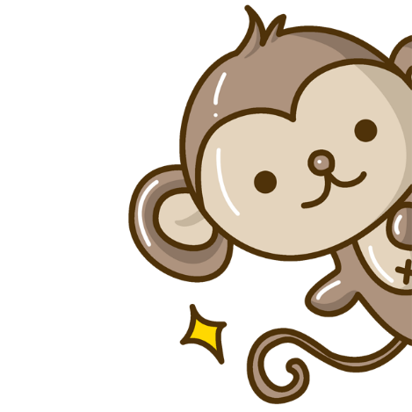

Who’s faster ?

Slide 17


Notes:
Listen and sing. Track 53
- Play the song.
- Demonstrate an action for each animal.
- Play the recording again and students listen and point to the animals as they hear the words.
- Practice several times singing and doing the actions.

Slide 18
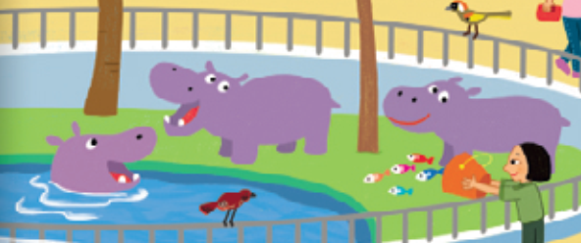
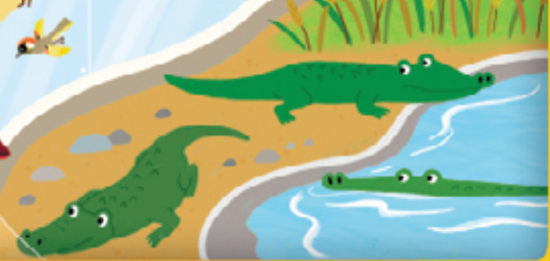
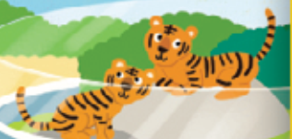
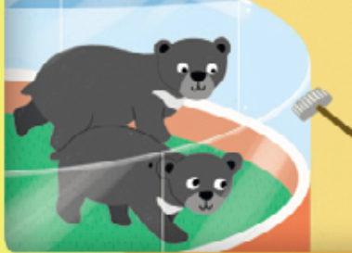
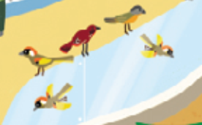
Let’s talk !
Notes:
- Ask students to look at the picture and the words in the speech bubble. - Ask: What are they? (Two bears.)
- Have two students demonstrate the question in the speech bubble and the answer in the picture.
- Students work in pairs to ask and answer the question.

Slide 19

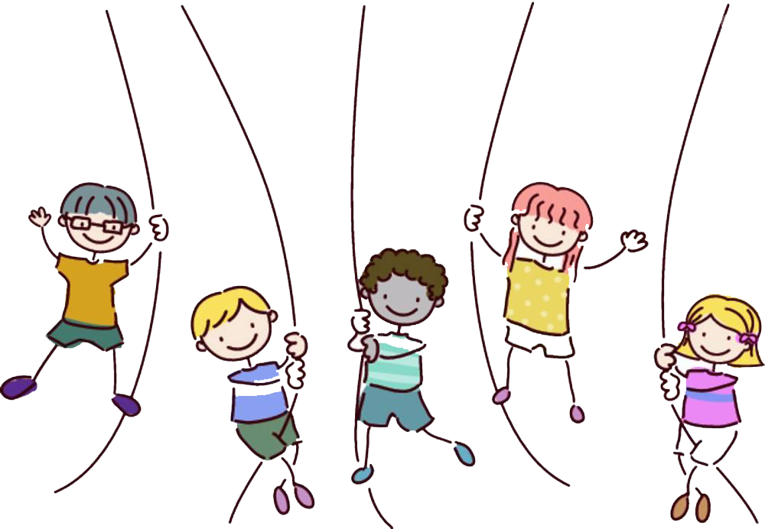
Goodbye!

